Slide 1

IMDB MOVIE ANALYSIS
TRAINITY
BY- ANURAG JOHN PHILLIPS

Slide 2

ROADMAP
PROJECT DESCRIPTION
TECH-STACK USED
RESULTS
APPROACH
INSIGHTS

Slide 3
PROJECT DESCRIPTION
The objective of this project is to analyse the IMDB movie dataset and derive insights from it. This dataset has several columns, and we need to manipulate the data using Excel formulas.
Various tasks are required to be completed such as determining the most common genres, analysing the impact of genres on IMDB scores, examining the distribution of movie durations, identifying top directors based on their average IMDB scores, exploring the relationship between movie budgets and gross earnings, and calculate profit margins for each movie.

Slide 4
APPROACH
To execute the project, I first familiarized myself with the dataset and identified relevant columns for analysis.
I then cleaned the data and removed unnecessary columns and rows which had null values, or which were not relevant for our tasks.
BEFORE CLEANING
AFTER CLEANING
COLUMNS – 28
ROWS - 5044
COLUMNS – 9
ROWS - 3818
CLEANED DATASET LINK
https://docs.google.com/spreadsheets/d/1VHlnwRA8T787v9x_VETPmYuBhoGbM86Jj-bYPnQ_-Dc/edit?usp=sharing

Slide 5
WORKING EXCEL FILES
I have used these two excel files to do my analysis, reasons for dividing the Excel files into two files was, my system was getting hanging a lot when I was trying to do the analysis in just one files. The links of these files are:
https://docs.google.com/spreadsheets/d/1AIxcFU-PB3QepWV_ZjZWSRxYgenOf6bv/edit?usp=sharing&ouid=109466755193972209405&rtpof=true&sd=true
https://docs.google.com/spreadsheets/d/15pi7R1bcRgHN00UxFtUBvBsc4SVm454v/edit?usp=sharing&ouid=109466755193972209405&rtpof=true&sd=true

Slide 6
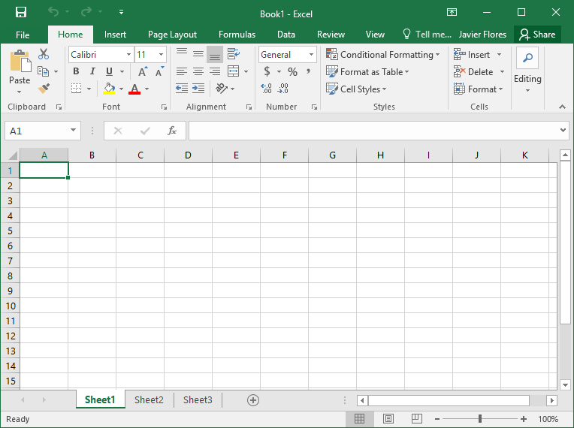
TECH-STACK USED
Microsoft Excel for Mac Version 16.74
My primary tool for Data Analysis was Microsoft Excel and various functions and features of Excel were used which are mentioned in the respective sheets to calculate descriptive statistics, find correlations, and identify top directors and movies with the highest profit margins

Slide 7

A. MOVIE GENRE ANALYSIS
IMDB MOVIE ANALYSIS
Determine the most common genres of movies in the dataset. Then, for each genre, calculate descriptive statistics (mean, median, mode, range, variance, standard deviation) of the IMDB scores.
IMDB MOVIE ANALYSIS

Slide 8
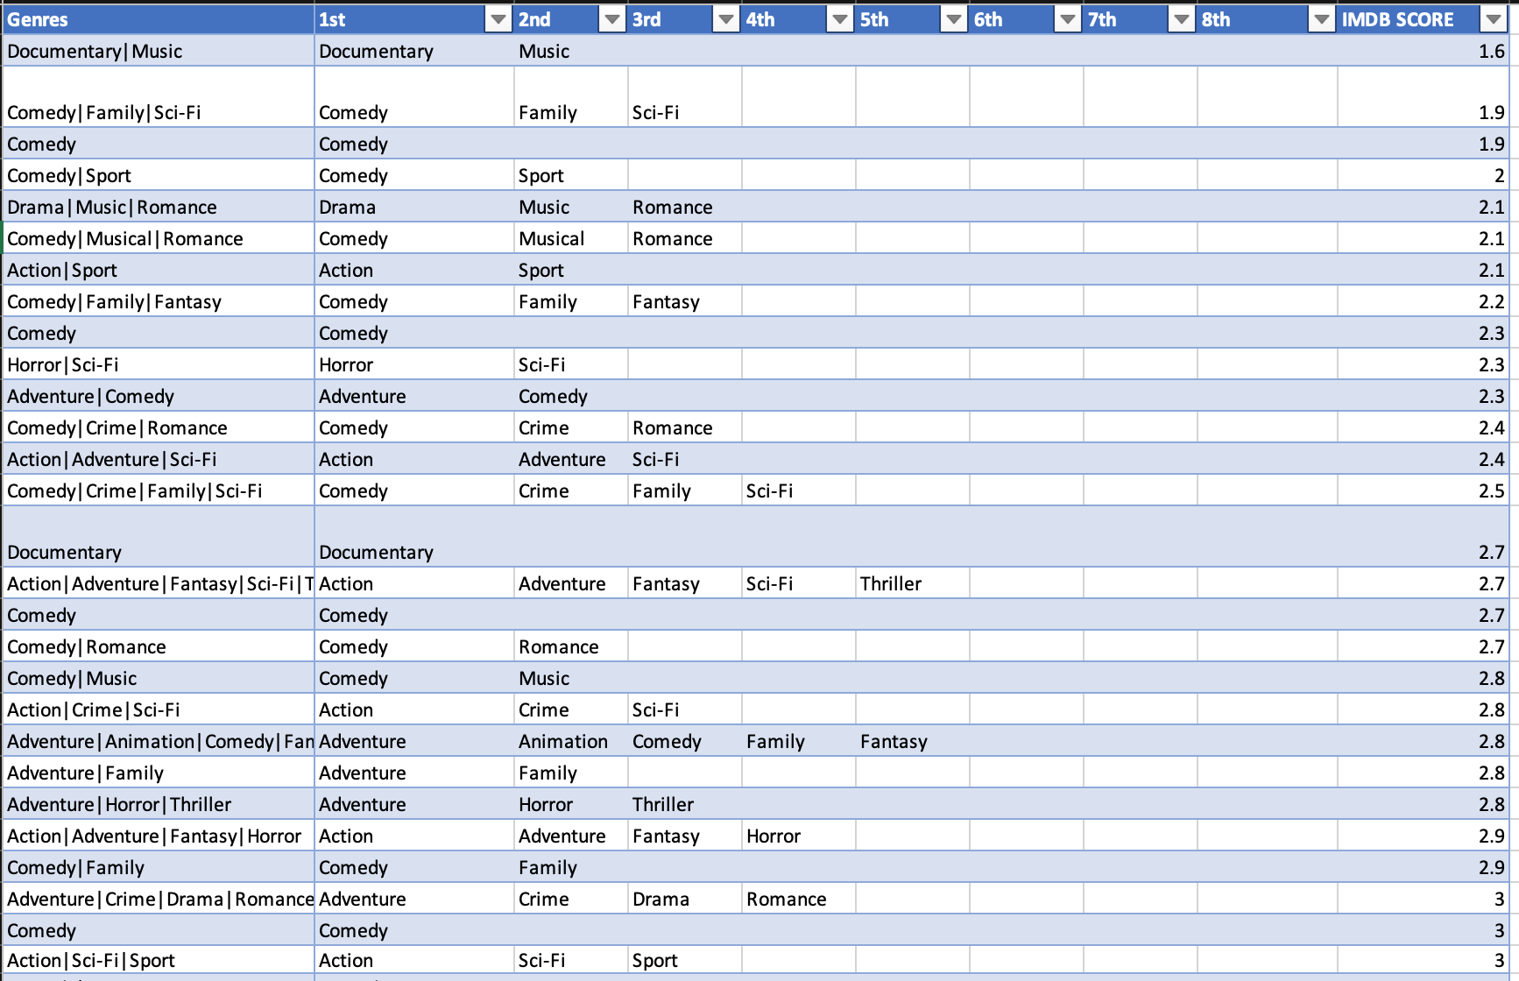
Here I have divided the Genre Column into different columns based on “ | ” .
I used the function Text to Columns, which is under Data Tab

Slide 9
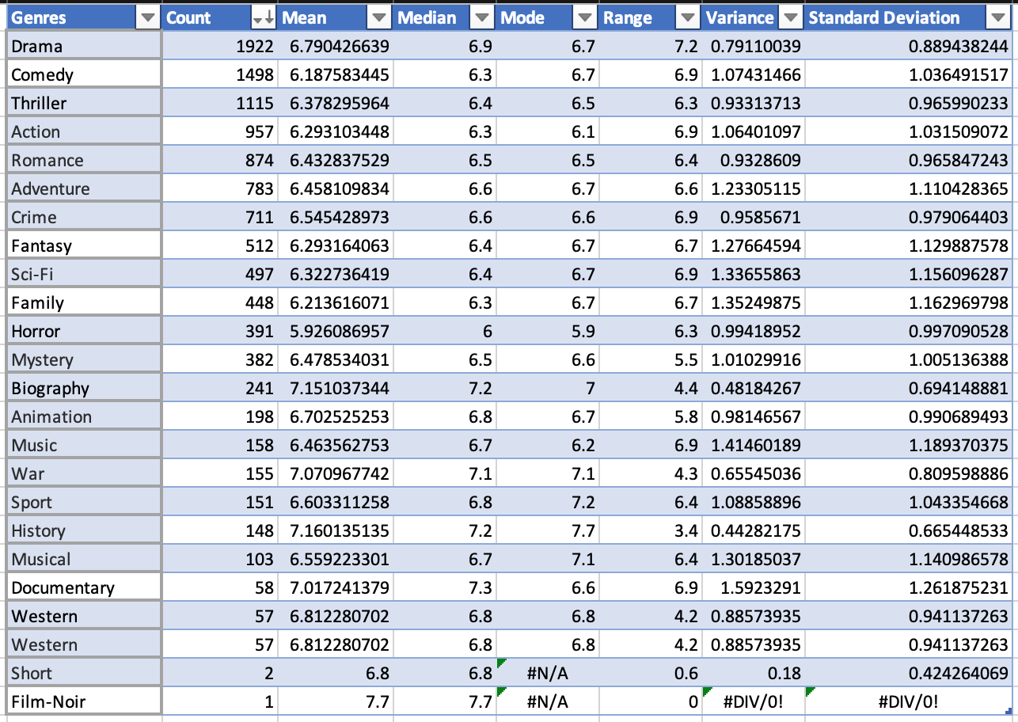
Excel Formula Used
To count the number of movies in each genre- =COUNTIF(Table3[[1st]:[8th]],L2)
To calculate Genre Mean – =AVERAGE(FILTER($J$2:$J$3818, ISNUMBER(SEARCH(L2, $A$2:$A$3818))))
To calculate Genre Median – =MEDIAN(FILTER($J$2:$J$3818, ISNUMBER(SEARCH(L2, $A$2:$A$3818))))
To calculate Genre Mode – =MODE(FILTER($J$2:$J$3818, ISNUMBER(SEARCH(L2, $A$2:$A$3818))))
To calculate Genre Range – =MAX(FILTER($J$2:$J$3818,ISNUMBER(SEARCH(L2,$A$2:$A$3818))))-MIN(FILTER($J$2:$J$3818,ISNUMBER(SEARCH(L2,$A$2:$A$3818))))
To calculate Genre Variance– =VAR(FILTER($J$2:$J$3818, ISNUMBER(SEARCH(L2, $A$2:$A$3818))))
To calculate Genre Standard Deviation– =STDEV(FILTER($J$2:$J$3818, ISNUMBER(SEARCH(L2, $A$2:$A$3818))))

Slide 10

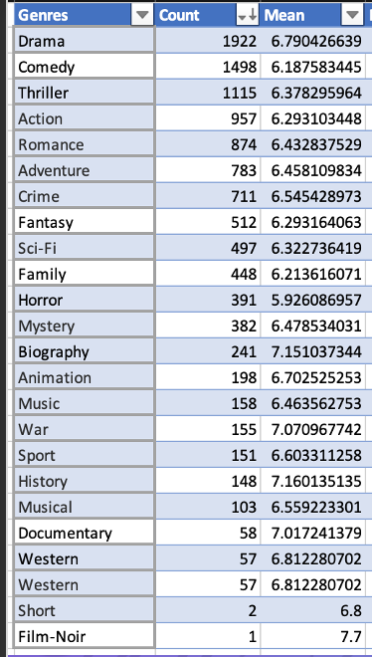
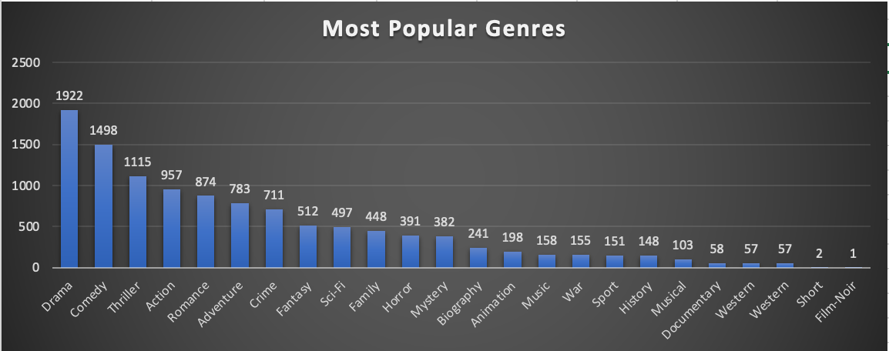
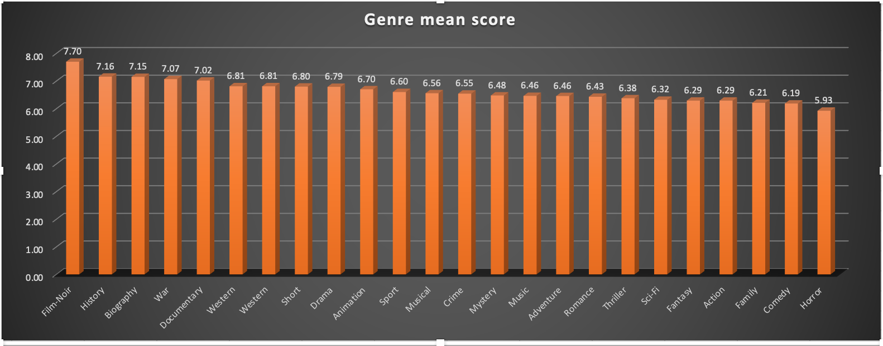
FINDINGS
Drama, Comedy, and Thriller are the most common genres, with a high number of movies in each genre.
History, Biography, War and Documentary, have higher Mean IMDB scores. This indicates that movies in these genres generally receive better ratings from viewers.
Horror and Comedy have lower Mean IMDB scores, which indicates that movies in these genres might receive relatively lower ratings.
Adventure and Fantasy genres have a wider range of IMDB scores, meaning that some movies in these genres have very high ratings, while others have lower ratings.
Drama and Romance, have similar mean, median, and mode scores, showing a relatively balanced distribution of ratings.

Slide 11
B. MOVIE DURATION ANALYSIS
IMDB MOVIE ANALYSIS
Analyse the distribution of movie durations and identify the relationship between movie duration and IMDB score
IMDB MOVIE ANALYSIS

Slide 12
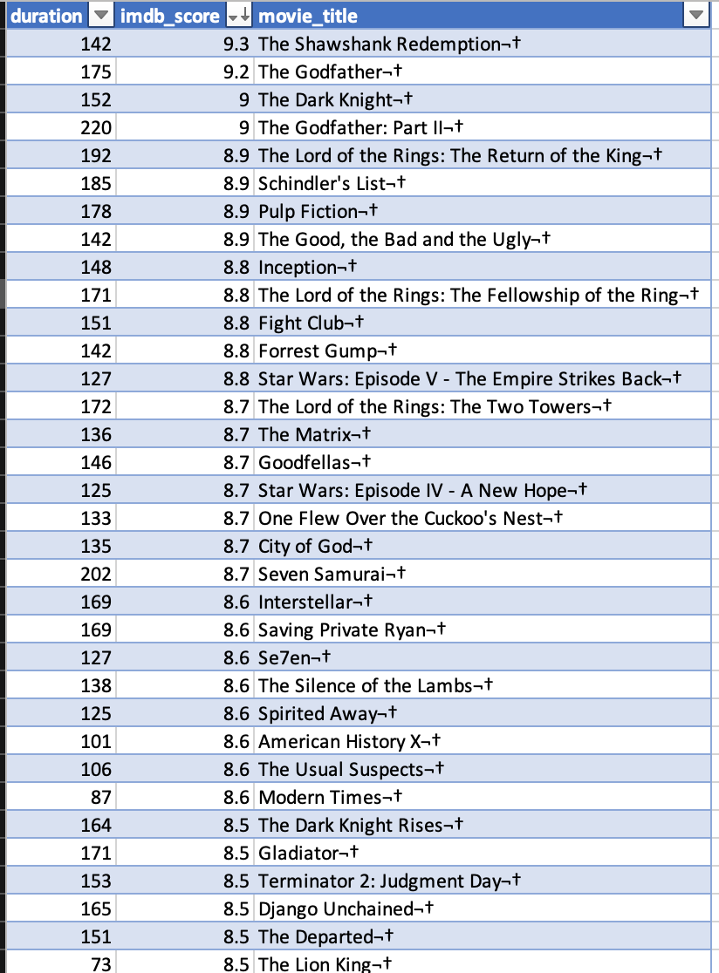
FOR MOVIE DURATION ANALYSIS DURATION AND IMDB_SCORE COLUMNS
FROM THE DATASET
ARE CHOSEN FOR ANALYSIS

Slide 13
 | Mean | Median | Standard Deviation
Duration | 110.01 | 106 | 22.79
IMDB Score | 6.47 | 6.6 | 1.05
From the above statistics, we can observe the following:
The Mean and Median of Duration are relatively close, suggesting that the distribution of movie durations are roughly symmetric.
The Standard Deviation for movie durations is larger than the standard deviation for IMDb scores, indicating that movie durations have more variability compared to IMDb scores..

Slide 14
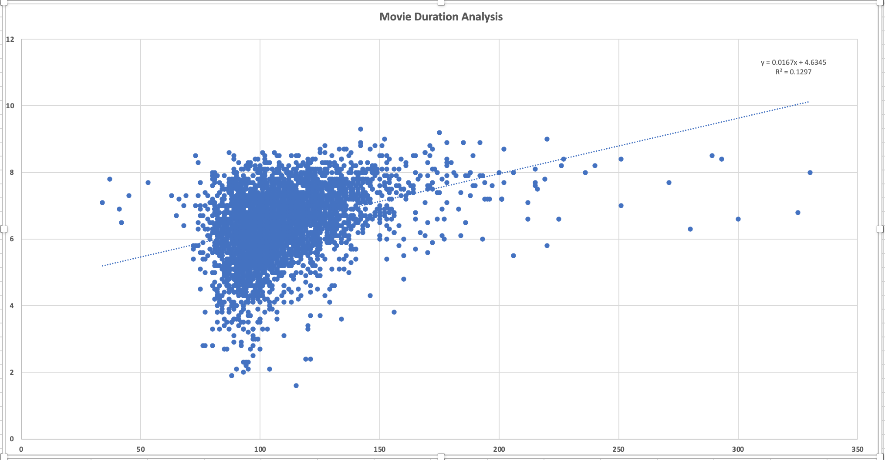
y = 0.0167x + 4.6345 R² = 0.1297
To determine a relationship between movie duration and IMDb score, I plotted movie duration (x) and IMDb score (y) on a scatter plot and added the trendline to observe the direction and strength of the relationship visually.
The equation (y = 0.0167x + 4.6345) shows a positive linear relationship between movie duration and IMDb score . However, the coefficient of determination- R² value (0.1297) indicates that only 12.97% of the variation in IMDb scores can be explained by the variation in movie durations. This suggests that there is a weak positive relationship between duration of the movie and its IMDB Score, what it means it that duration of the movie is not a big factor in the increase or decrease of their IMDB Scores, other factors also influence IMDb scores.

Slide 15
C. LANGUAGE ANALYSIS
IMDB MOVIE ANALYSIS
Determine the most common languages used in movies and analyse their impact on the IMDB score using descriptive statistics.
IMDB MOVIE ANALYSIS

Slide 16
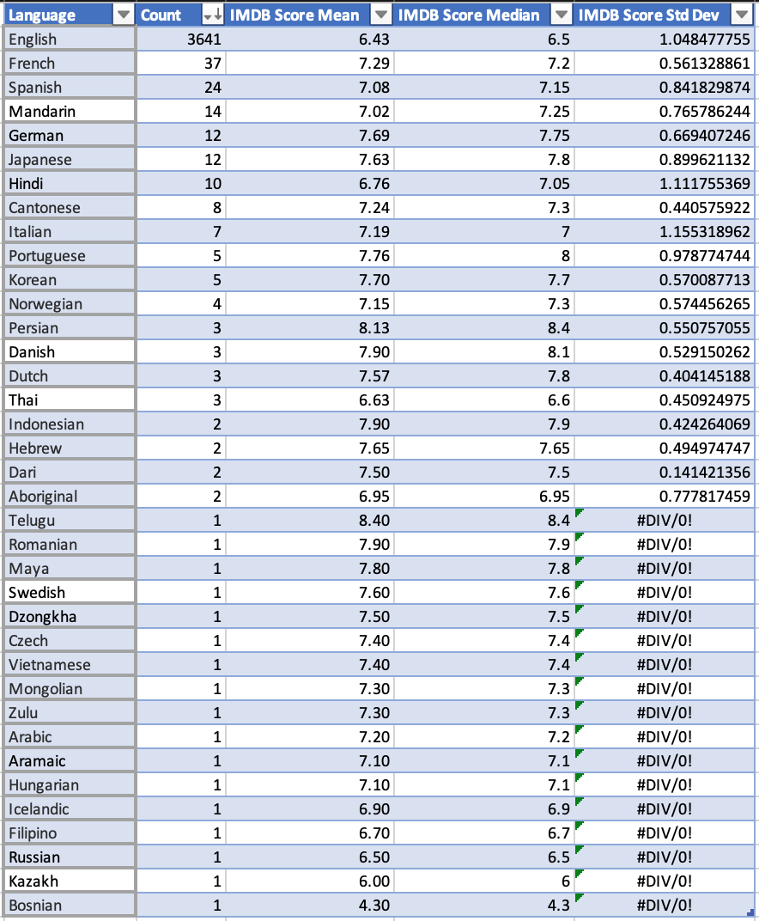
EXCEL FORMULAES USED:
To get unique languages from Languages column =UNIQUE(Table2[language],FALSE,FALSE)
To calculate count for “English” =COUNTIF(Table2[language],D2)
Languages with a larger number of movies have more reliable statistics, as the data is more representative of the overall movie population that is why for our analysis, we have taken only those movies whose language count is equal to or more than 5 movies per language.
Mean and Median of IMDB Score - helps us understand the overall reception of movies in each language. Languages with a high number of movies and relatively high IMDb Score Means and Medians indicates that these languages have consistently produced well-received movies.
Standard Deviation of IMDb Score - higher standard deviations suggests that there are many good and bad movies in these languages

Slide 17
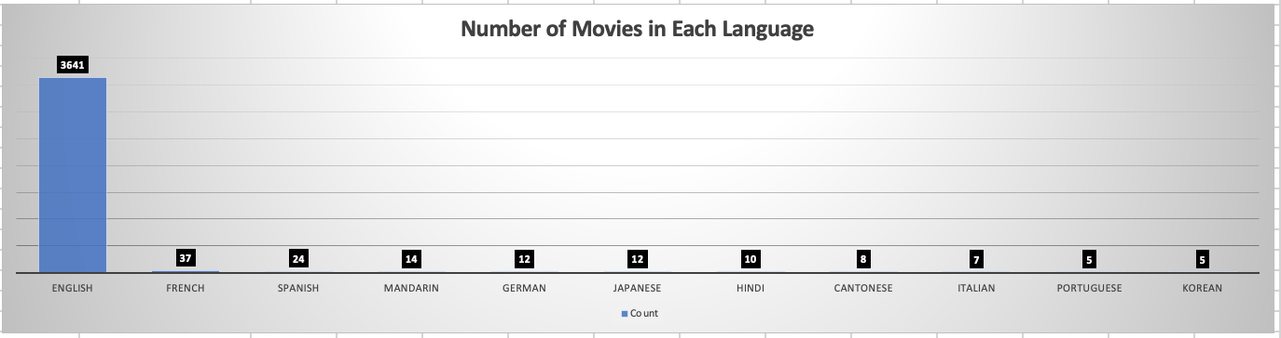
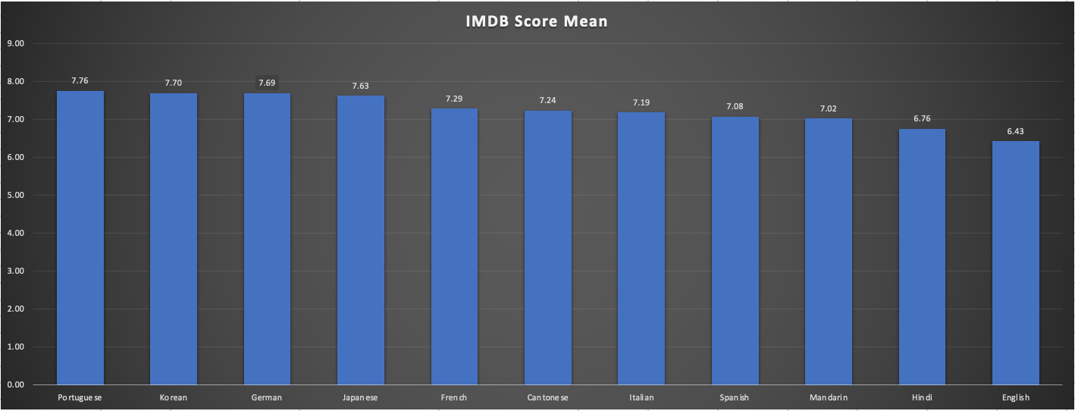
Number of movies in each language
Mean IMDB Score of different Languages

Slide 18
FINDINGS
English has the most movies in the dataset, with a mean IMDB score of 6.43 and a median IMDB score of 6.5
French has the second highest count with a mean IMDB score of 7.29 and a median IMDB score of 7.2
Spanish has the third highest count, with a mean IMDB score of 7.08 and a median IMDB score of 7.15
Portuguese, Korean and German language movies have the highest Mean IMDB Score, but the number of movies in each language are less compared to English

Slide 19
D. DIRECTOR ANALYSIS
IMDB MOVIE ANALYSIS
Identify the top directors based on their average IMDB score and analyse their contribution to the success of movies using percentile calculations.
IMDB MOVIE ANALYSIS

Slide 20
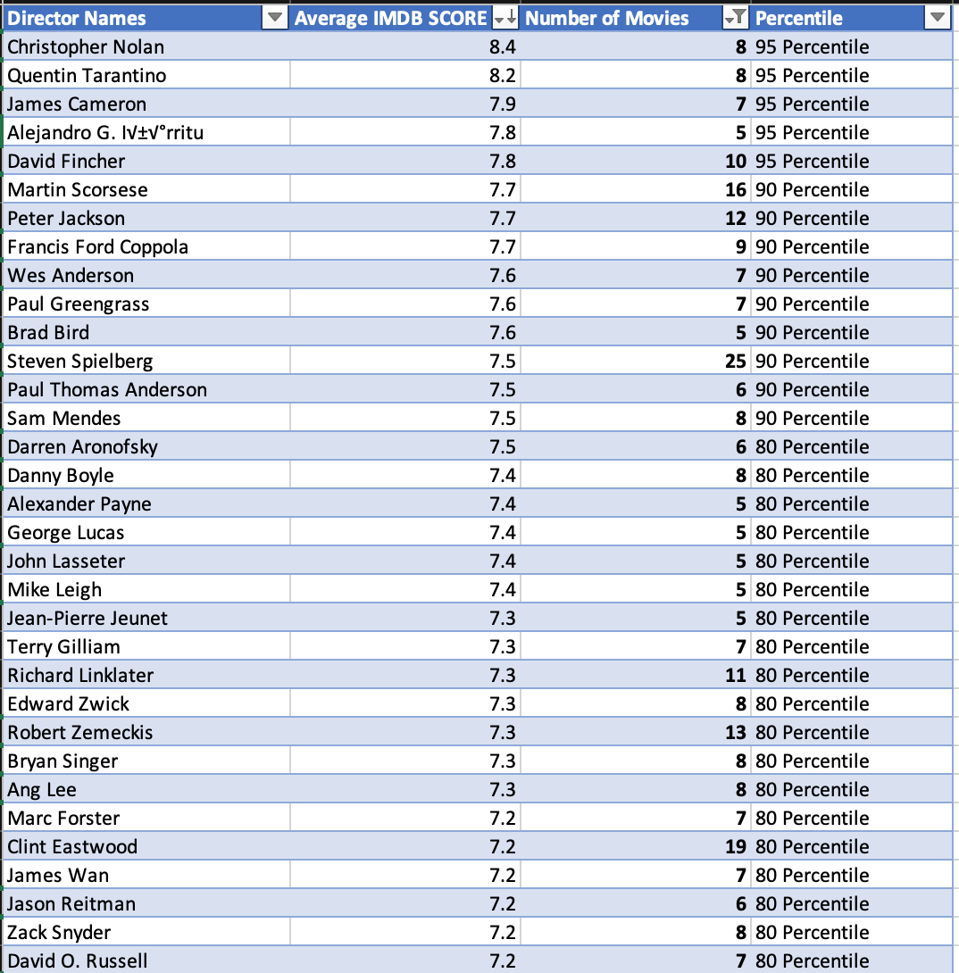
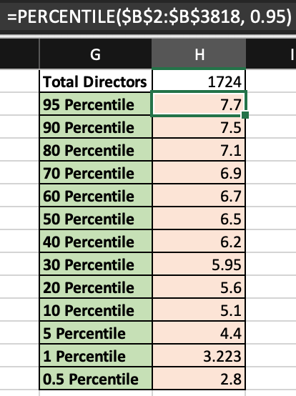
EXCEL FORMULAS USED
To get Unique Directors Name- =UNIQUE(Table4[director_name],FALSE,FALSE)
To get Mean IMDB Score of Each Director- =AVERAGEIF($A$2:$A$3818, F2, $B$2:$B$3818)
To calculate Percentile- --→ =PERCENTILE($B$2:$B$3818, 0.95)
To get number of Movies for each Director-
=COUNTIF(Table4[director_name],F2)
To automatically populate Percentile column according to their Average IMDB Score- =IF(B2>=$H$2,$G$2,IF(B2>=$H$3, $G$3,IF(B2>=$H$4, $G$4,IF(B2>=$H$5, $G$5,IF(B2>=$H$6, $G$6,IF(B2>=$H$7, $G$7,IF(B2>=$H$8, $G$8,IF(B2>=$H$9, $G$9,IF(B2>=$H$10, $G$10,IF(B2>=$H$11, $G$11,IF(B2>=$H$12, $G$12,IF(B2>=$H$13, $G$13,IF(B2>=$H$14, $G$14,"Low Percentile")))))))))))))
For our analysis I have taken those directors who have number of movies equal to or greater than 5

Slide 21
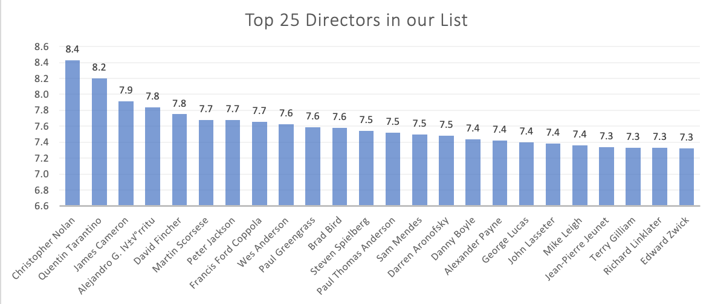
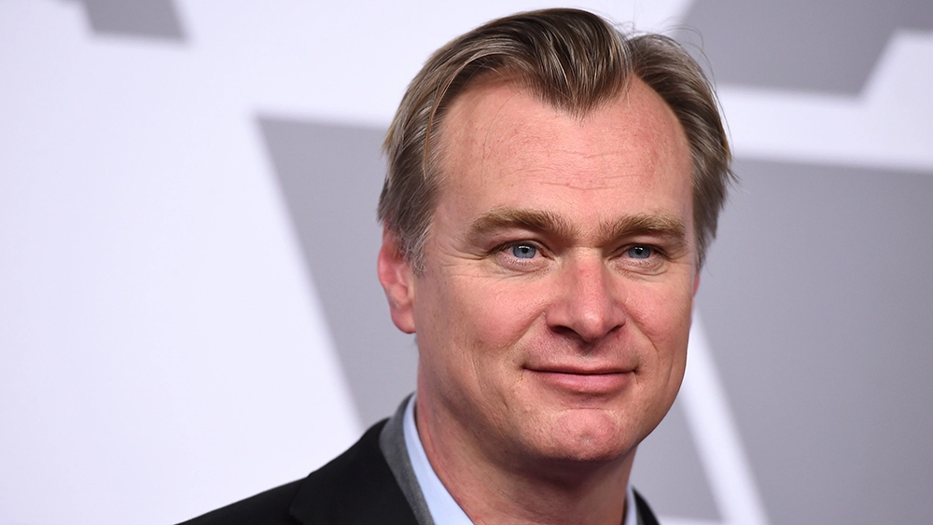


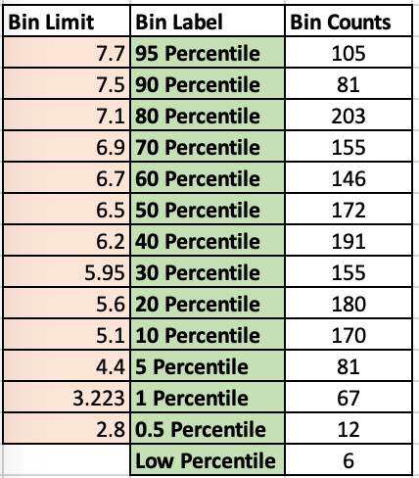
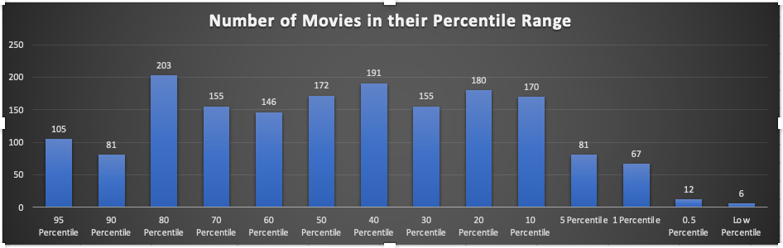
We see the TOP 25 Directors in our list and the number of movies in their Percentile Range in the graph below

Slide 22
E. BUDGET ANALYSIS
IMDB MOVIE ANALYSIS
Analyse the correlation between movie budgets and gross earnings and identify the movies with the highest profit margin.
IMDB MOVIE ANALYSIS

Slide 23
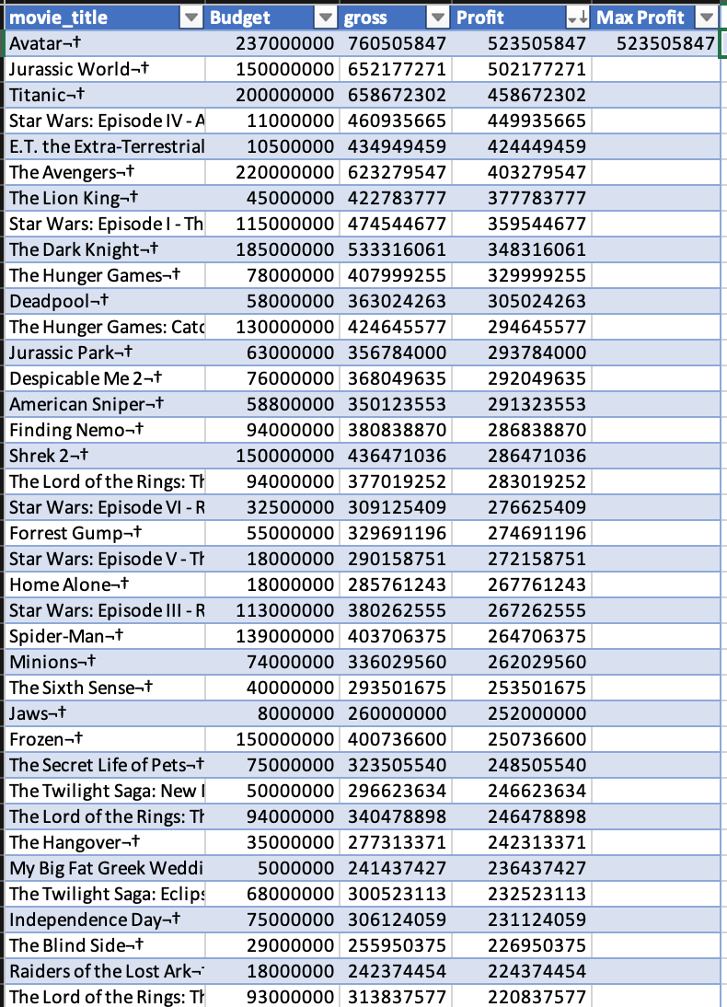
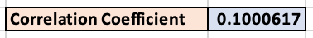
EXCEL FORMULAS USED
To calculate Profit Margin =[@gross]-[@Budget]
To get highest Profit Margin =MAX([Profit])
To calculate Correlation Coefficient =CORREL(Table8[Budget],Table8[gross])
A correlation coefficient of 0.1000617 indicates a weak positive correlation between Movie Budgets and Gross Earnings. This means that there is a slight tendency for movies with higher budgets to have higher gross earnings, however there are many movies with high budgets that did not have high gross earnings, and vice versa.

Slide 24
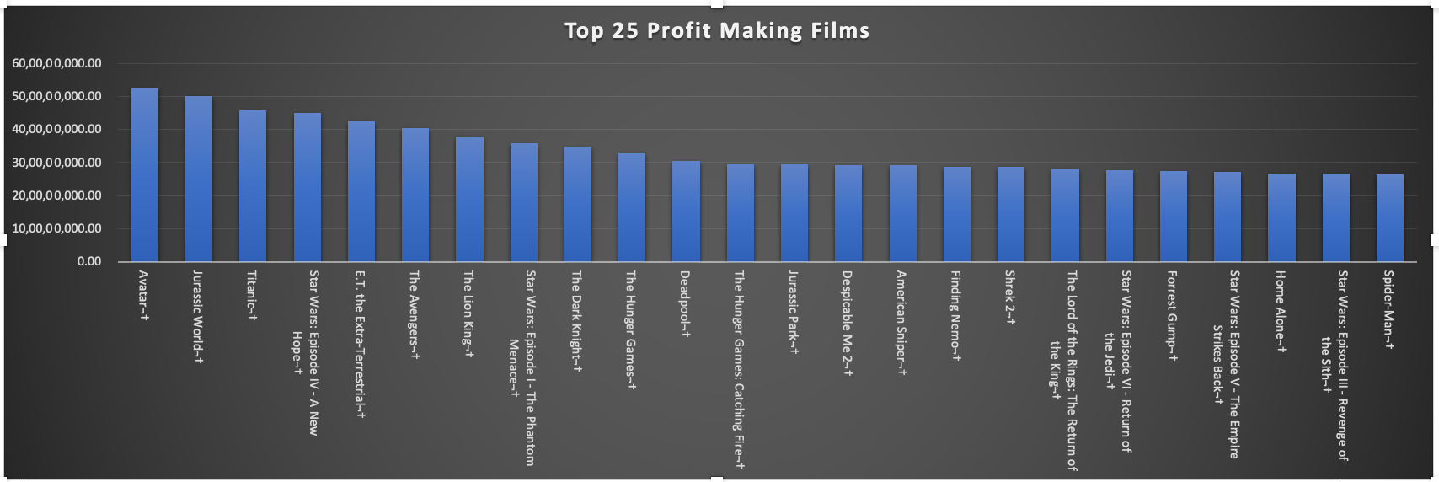



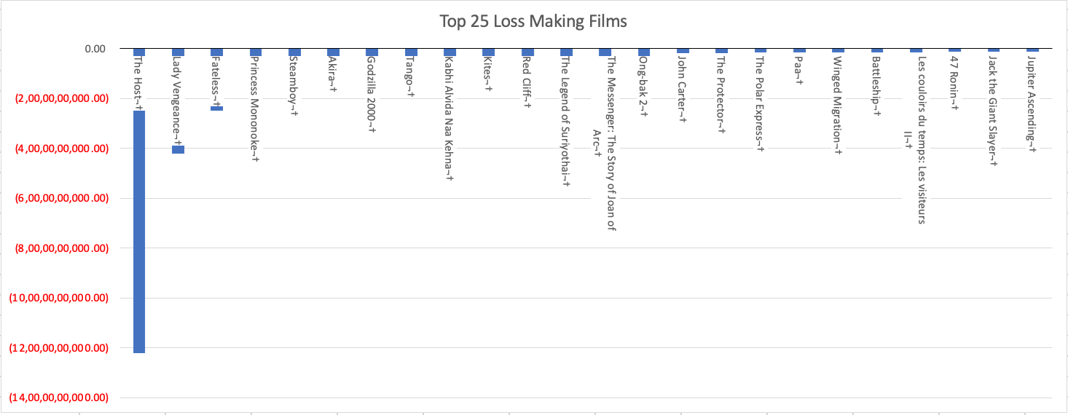

Top 25 Profit - and Loss-Making movies in our datasheet.
25 Most Loss-Making Films

Slide 25
RESULT
In this project, I successfully analysed various aspects of the IMDB movie dataset and provided meaningful insights into the distribution of genres, their impact on IMDB scores, movie durations, top directors, and the relationship between movie budgets and gross earnings.
The insights which I got are:
Movie Genre Analysis- Drama, Comedy and Thriller are the most common genres
Movie Duration Analysis- Shows that there is a weak positive relationship between the duration of the movie and its IMDB Score and other factors also influence IMDb scores
Language Analysis- English, French and Spanish are the most common languages in our IMDB dataset
Director Analysis- Christopher Nolan, Quentin Tarantino and James Cameron are the top 3 directors who are above 95 percentile range and have the highest Mean IMDB Score
Budget Analysis- Avatar, Jurassic World and Titanic are the top 3 movies with the highest Profit Margins
This analysis has contributed to a better understanding of the factors influencing movie ratings and financial success, and it has provided valuable information for further exploration in the realm of movie analysis.

Slide 26
THANK YOU !

